Slide 1
Knights and Knaves Puzzle Generation
William Goubeaux

Slide 2
Determining Constraints
Decided to use truth tables in order to search for solutions
Would be bad for large groups of people, as computation gets too intense
Decided that a person would only ever say one thing about at most two people
What are the things that a person can say?

Slide 3
A Person φ and a Person Ψ
Φ
Ψ
~Φ
~Ψ
Φ ^ Ψ
~Φ ^ Ψ
Φ ^ ~Ψ
~Φ ^ ~Ψ
Φ v Ψ
~Φ v Ψ
~Φ v ~Ψ
Φ <-> Ψ
~Φ <-> Ψ

Slide 4
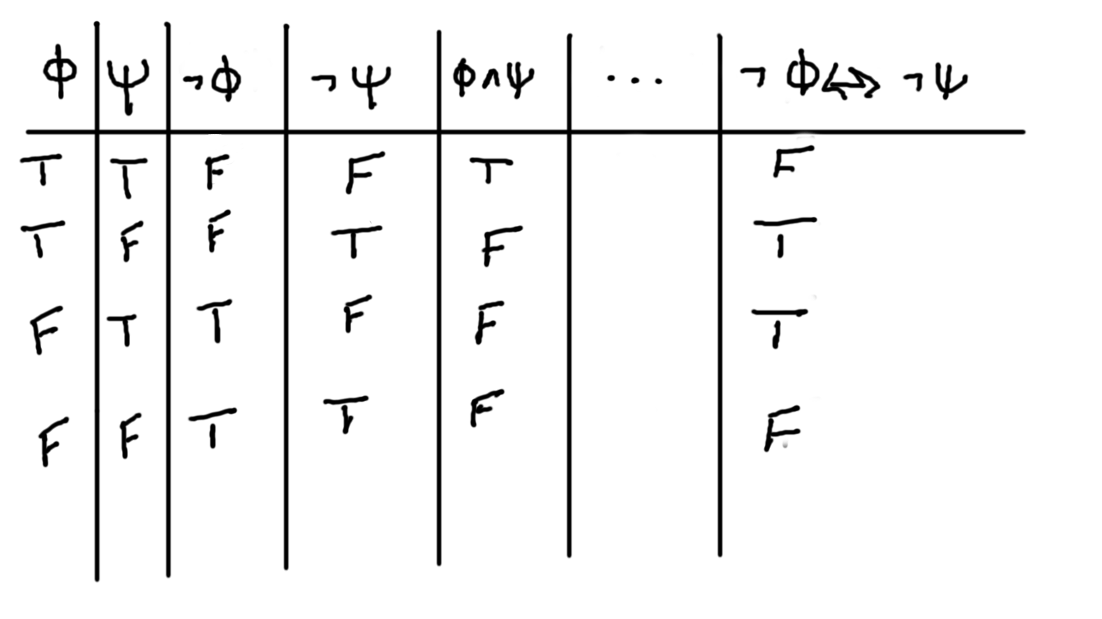
The Truth Table

Slide 5
Finding Solutions
Have a truth table now, but how do we find a solution?
Still need to choose what people are saying. This involves two steps
1. Generate combinations of what people can say from the truth table, e.g. Φ and Φ v Ψ, ~Φ v ~Ψ and Φ <-> Ψ, etc.
2. Generate permutations of how people will say these combinations, e.g. Φ says Φ and Ψ says Φ v Ψ.

Slide 6
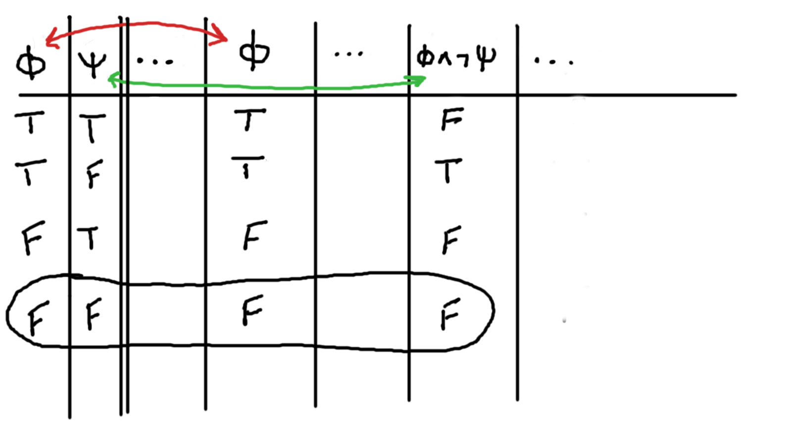
Finding a Solution Extended Example

Slide 7
Similar Solutions
Tried to make sure that problems did not have duplicates, e.g. Φ says Φ v Ψ vs Φ says Ψ v Φ
This happened for the most part, except ...
When two people have the same solution assignment (T and T or F and F), what they say doesn’t matter, since both of the statements have the same truth assignment.
Once people are given names, though logically very similar, the puzzles do seem different.

Slide 8
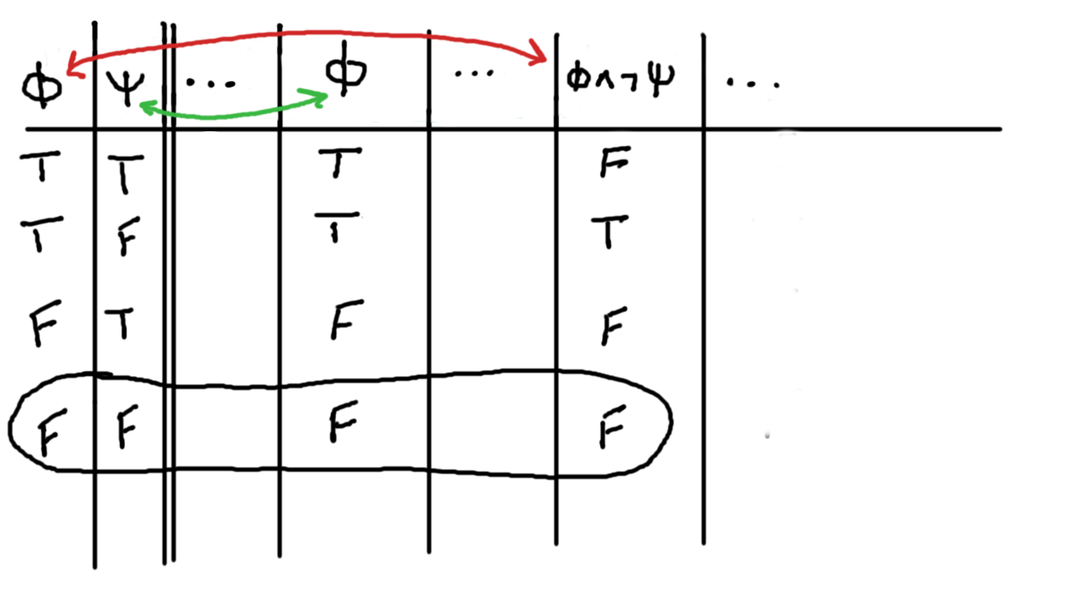
Example of Similar Solution

Slide 9
Some Results
The generation only ran up to 4 people.
74 solutions involving 2 people.
15,540 solutions involving 3 people.
6,562,536 solutions involving 4 people.
To go to higher numbers of people, it is probably necessary to look at the problem differently.
Maybe to generate a random solution and see if it is a valid puzzle.

